Slide 1

Customer Sentiment Analysis using Reviews

Slide 2
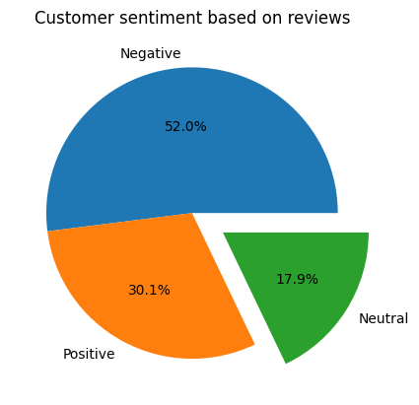
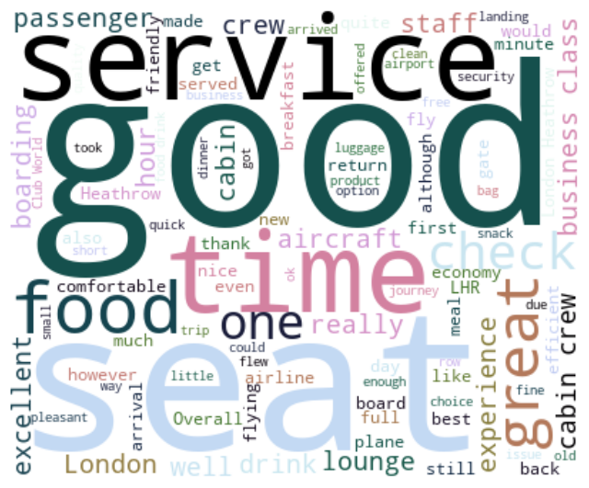
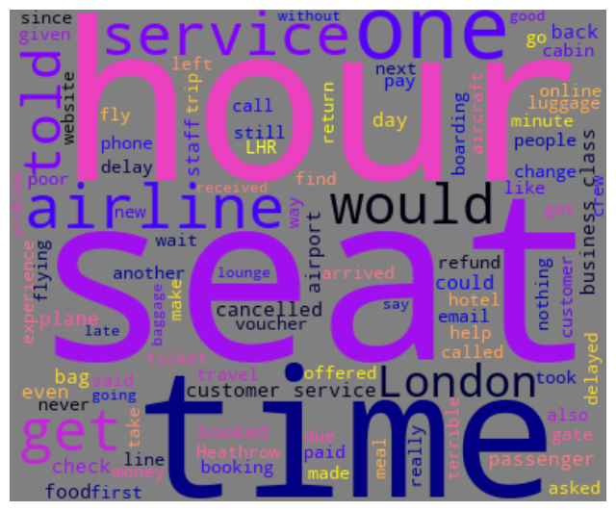
Summary of Insights
From the 1000 reviews analyzed:
520 reviews were classified as having negative sentiment.
301 reviews were classified as having positive sentiment.
179 reviews were found to have been neutral.
Negative worldcloud from the ‘Negative’ sentiment counts:
Customers seem to have complaints related to time.
Words relating services also seems to come up.
Cancellations and refunds also seems to among customer complaints.
Positive worldcloud from the ‘Positive’ sentiment counts:
Customers seem to bring up the food.
The service and the seat seem to come up the most in the positive reviews.
Positive Wordcloud
Negative Wordcloud

